Slide 1

AMSTer : SAR & InSAR Automated Mass processing Software for Multidimensional Time series
Nicolas d’Oreye^{1,2}, Dominique Derauw^{3,4}, Sergey Samsonov⁵,
Delphine Smittarello¹, Maxime Jaspard¹, Gilles Celli¹
ndo@ecgs.lu
amster@ecgs.lu
1 European Centre for Geodynamics and Seismology (ECGS), 19 rue Josy Welter, L-7256 Walferdange, Luxembourg
2 National Museum of Natural History (NMNH), 19 rue Josy Welter, L-7256 Walferdange, Luxembourg
3 Centre Spatial de Liège (CSL), Avenue du Pré Aily, B-4031 Angleur, Belgium
4 SAREOS, 1 Rue des Violettes, 4557 Fraiture, Belgium
5 Canada Centre for Mapping and Earth Observation, Natural Resources Canada (NRCAN), 560 Rochester Street, Ottawa, ON K1A 0E4, Canada

Slide 2
Summer School in InSAR, time series processing and deformation modelling
Exercises with your own data or
Coherence threshold, phase closure…
Nicolas d’Oreye

Slide 3
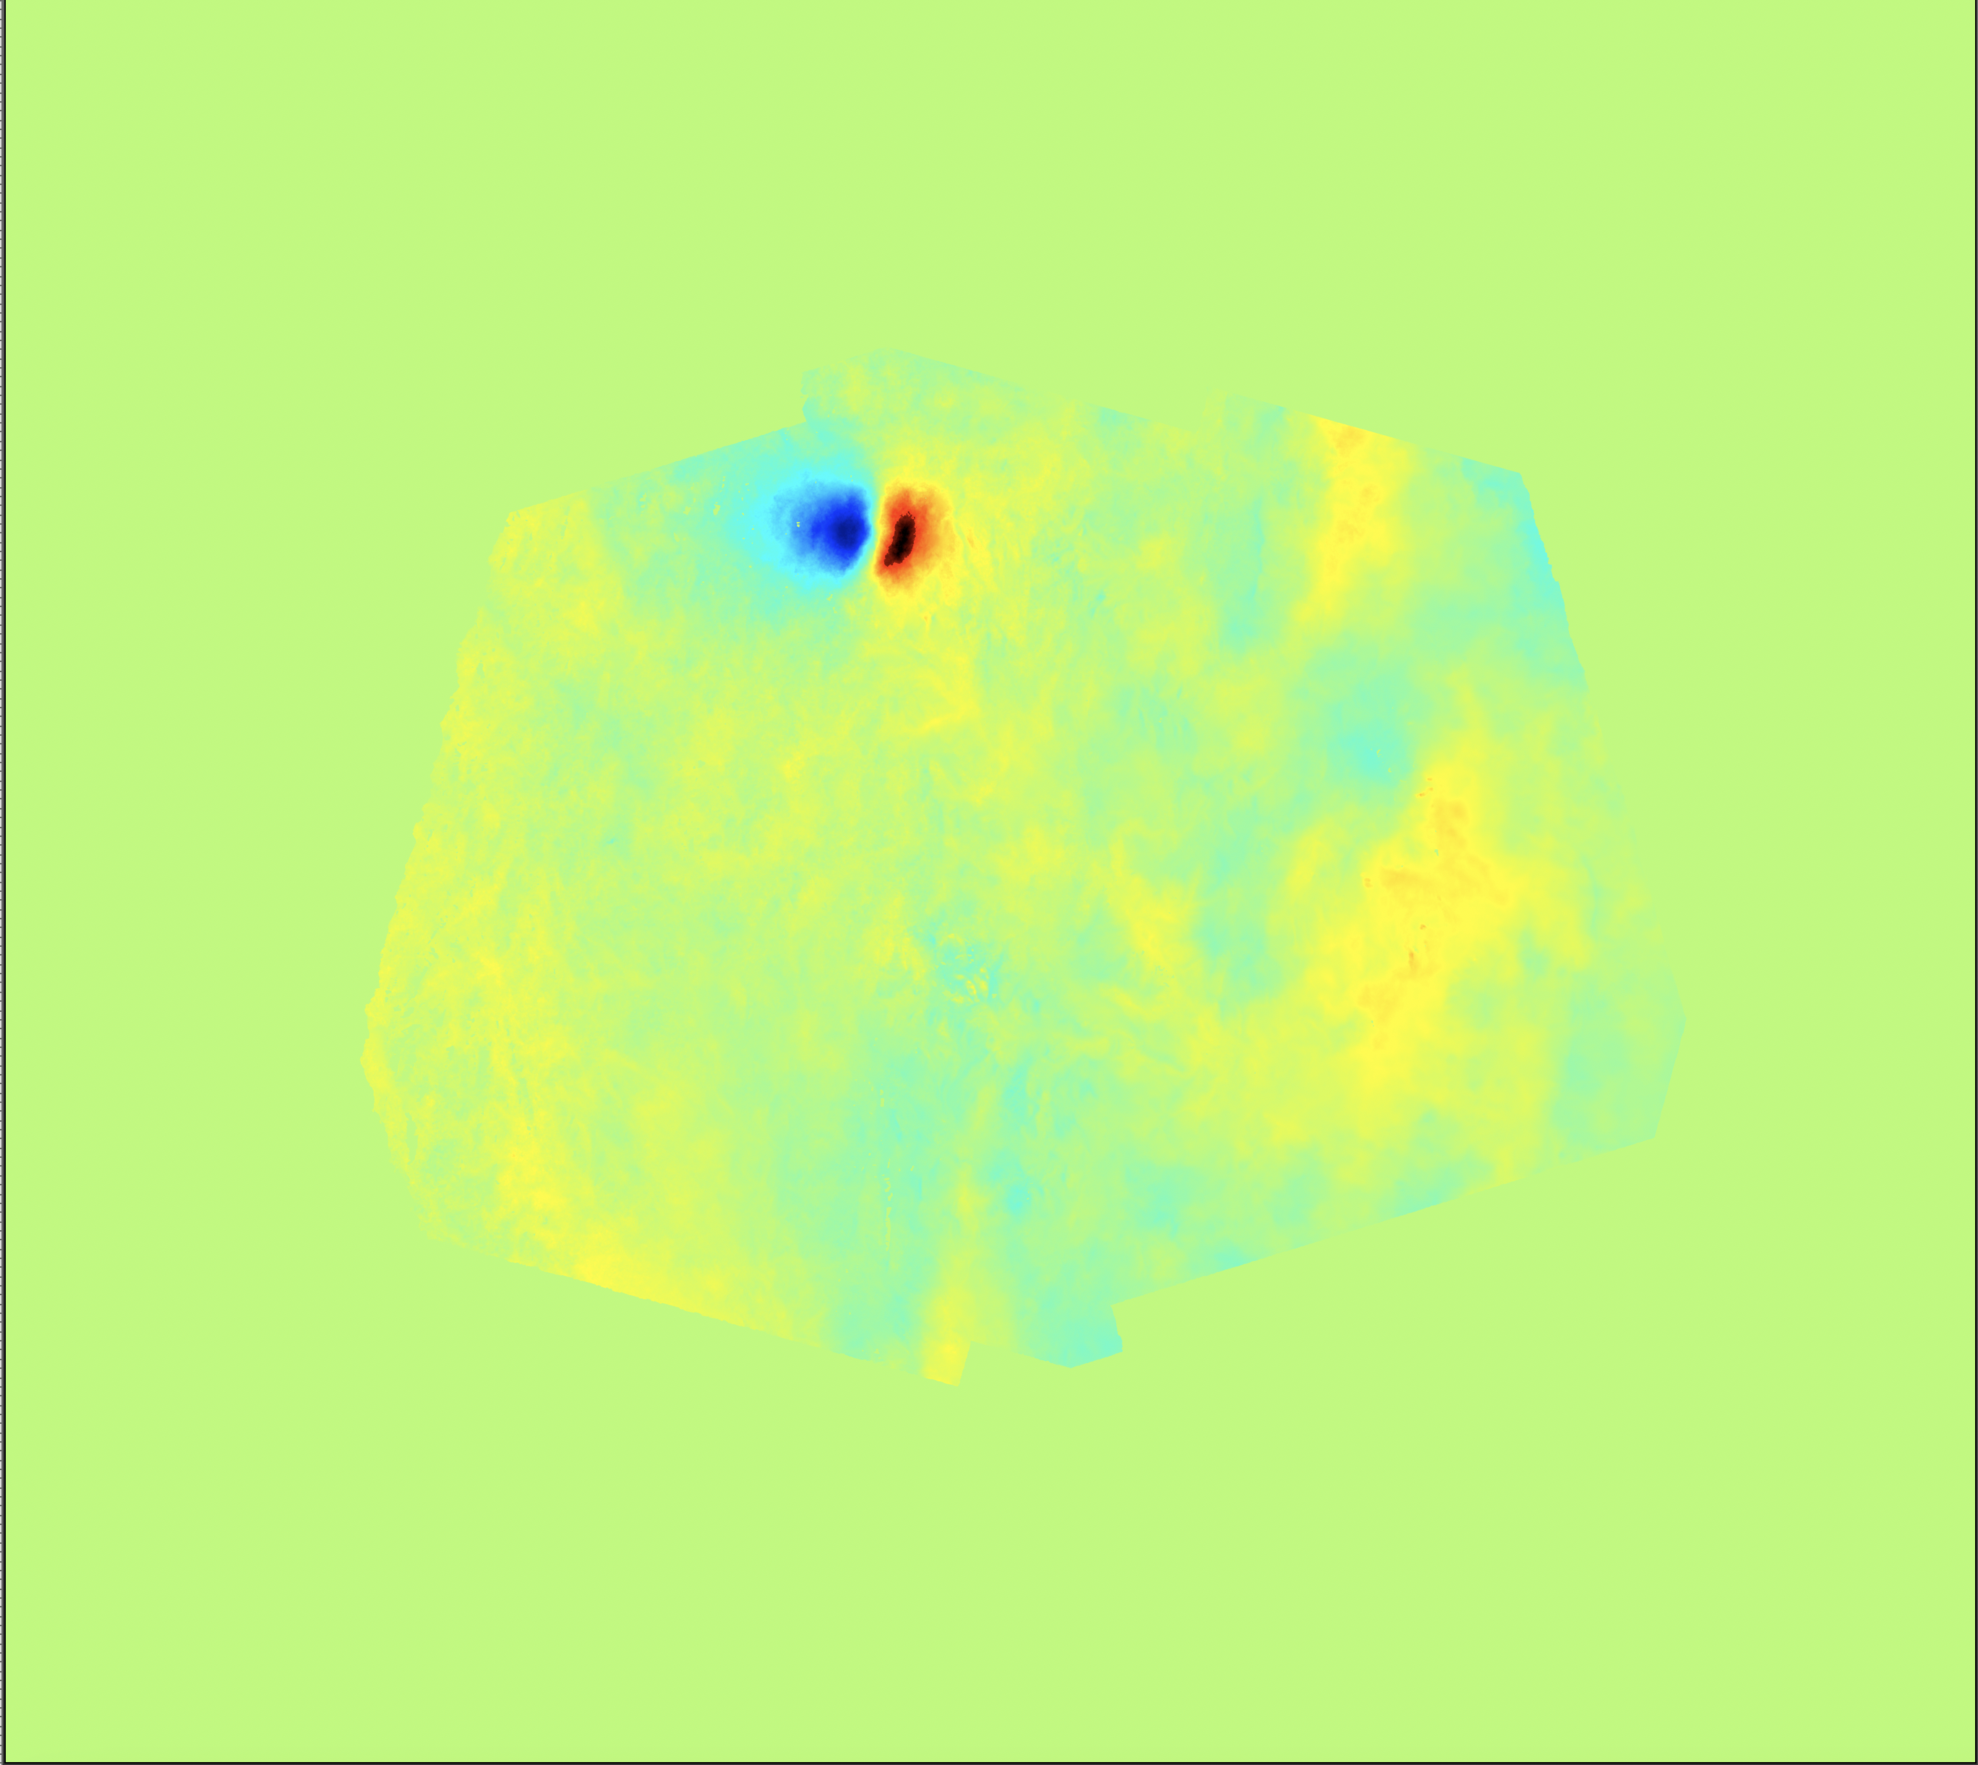
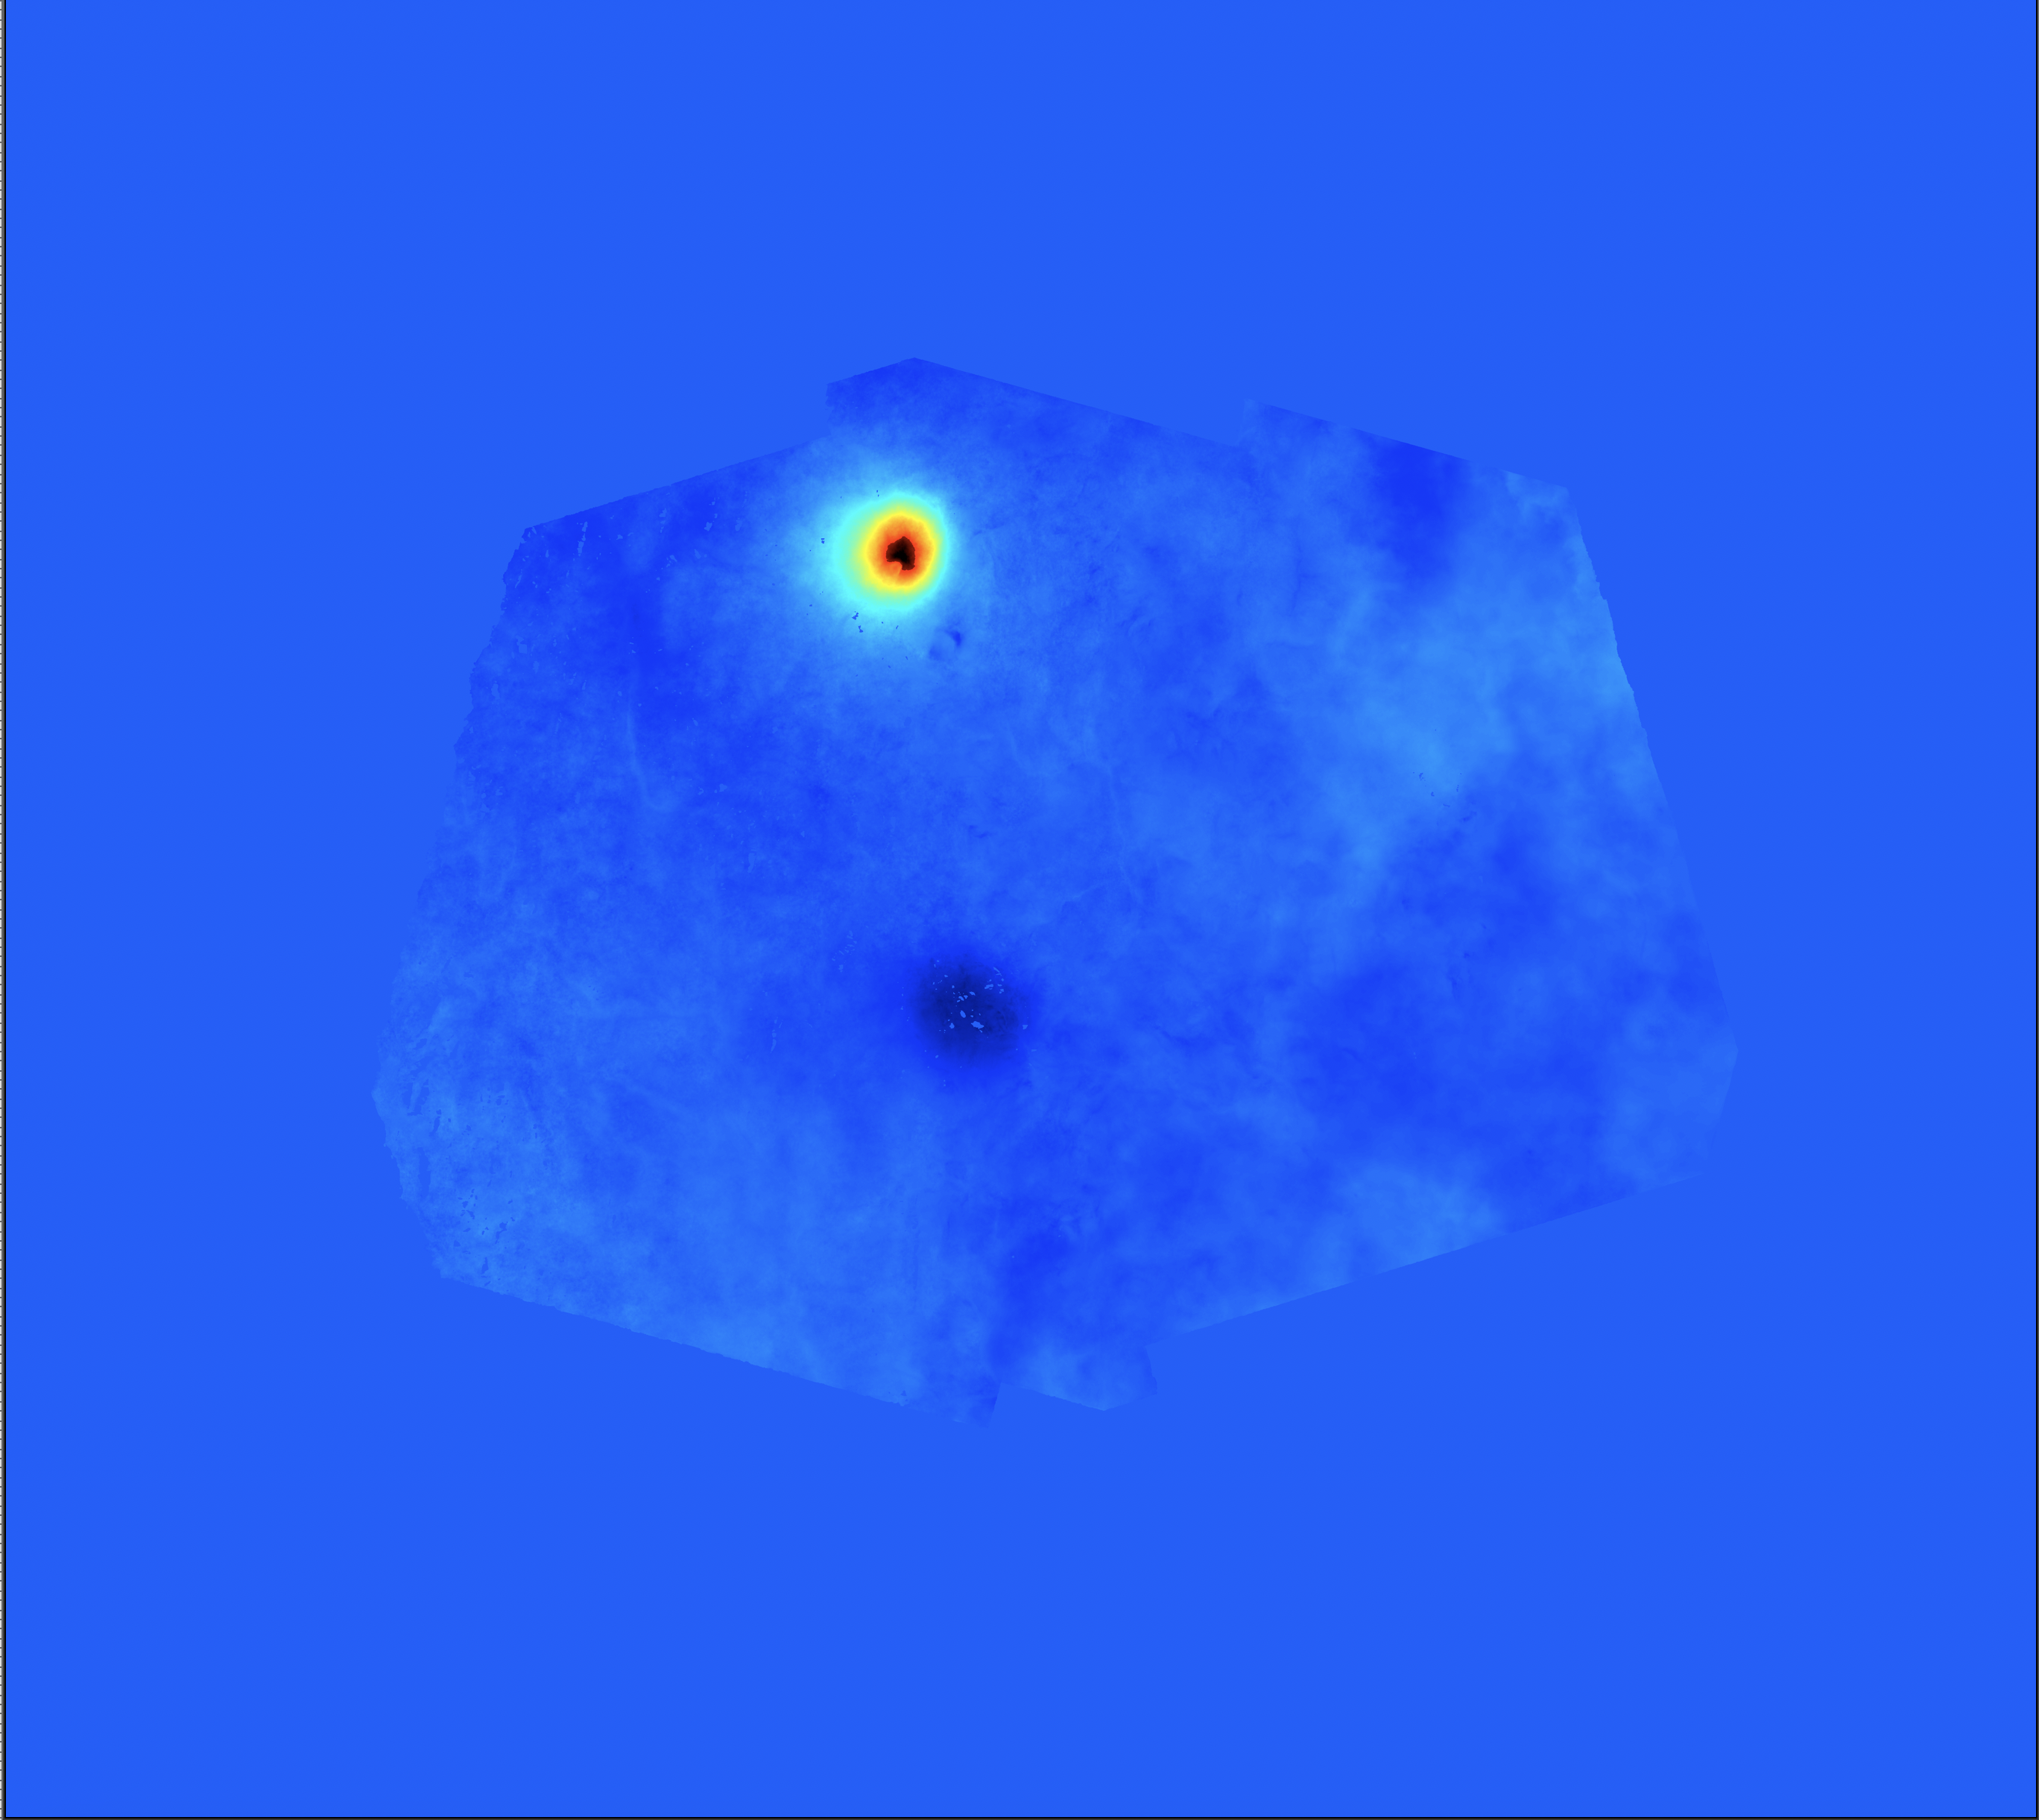
Exercise 4
Get back to MSBAS results for Domuyo and Laguna del Maule region in
…/3602/MSBAS/_Argentina_S1_20m_450days_NoOptim
Remember :
EW linear rate
UD linear rate
…/3602/MSBAS/_Argentina_S1_20m_450days_NoOptim/zz_Comp_2_0.04_NoCrop

Slide 4
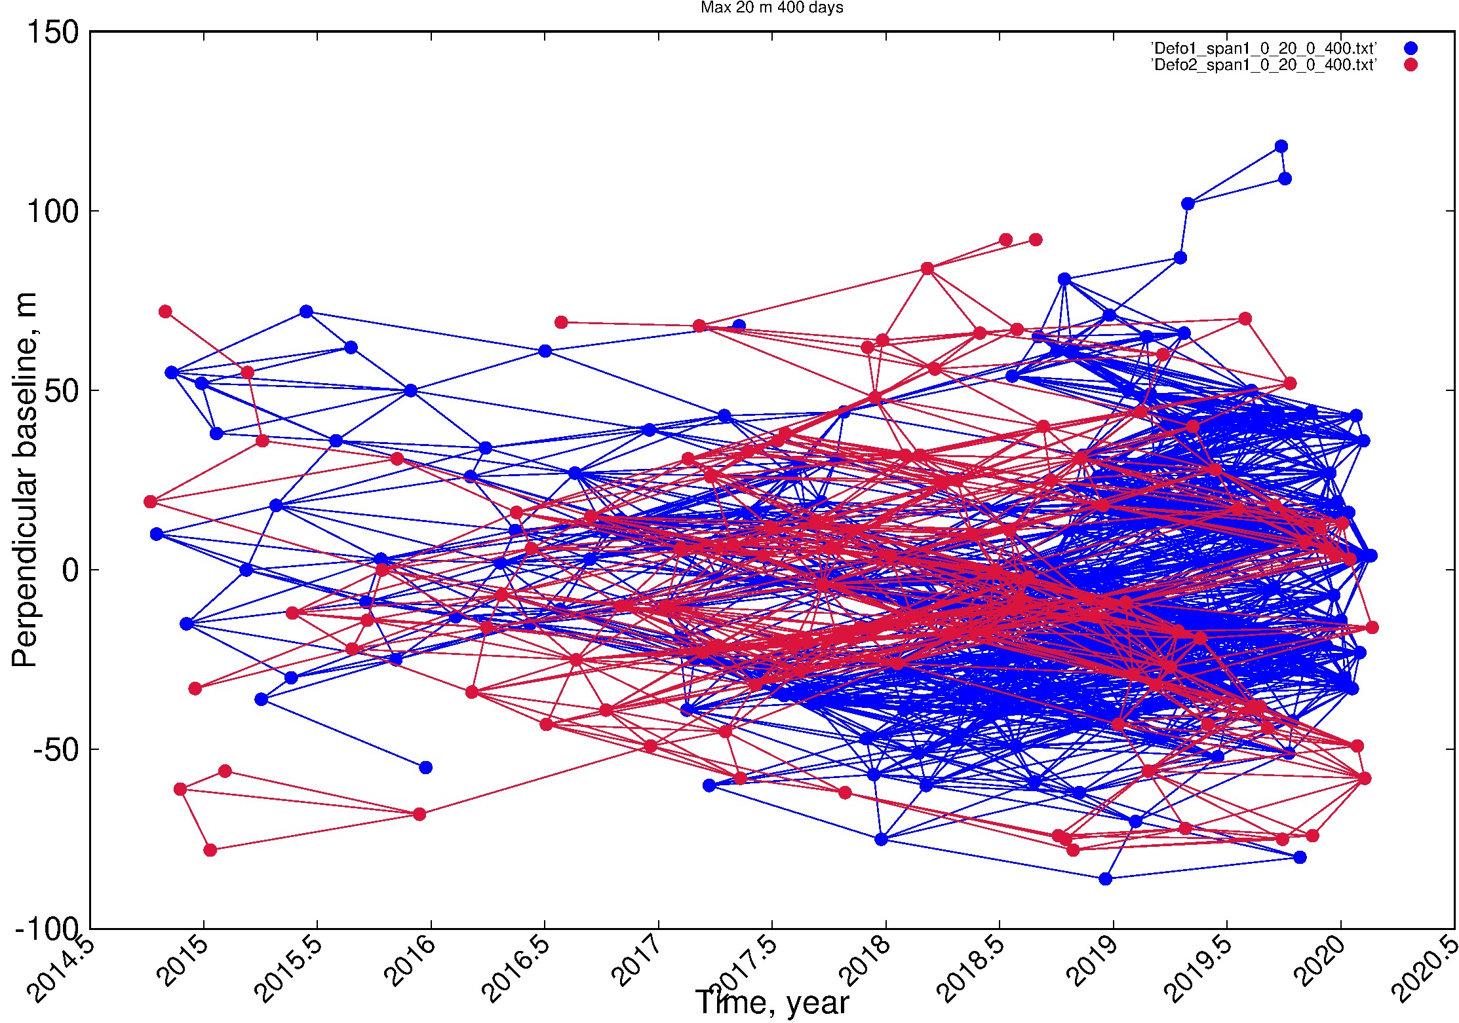
Exercise 4
➔ Coherence threshold
If the selectedd temporal baseline is long enough to keep coherent pairs from summer to summer, it may happen that, in the mean time, the winter would cause decorrelation between summer and winter time:
Max Btemp
Studies have shown that it could lead to severe signal underestimation (Smittarello et al. 2022) !

Slide 5
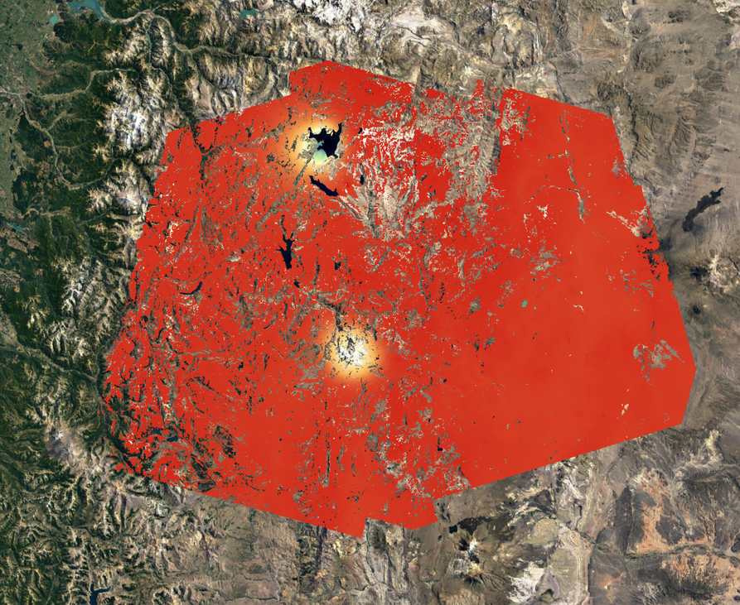
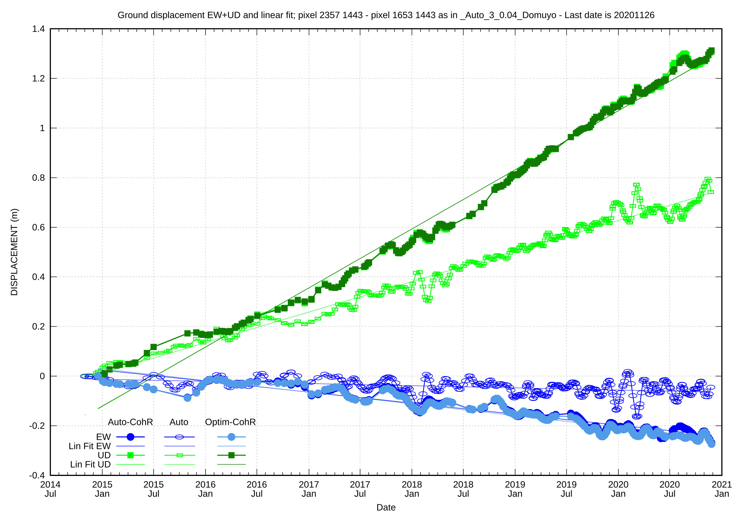
Exercise 4
2014-2020: Sentinel 1:
- Full: 2666 interferograms
- With Coh Threshold: 1013
- Optimized => -75 %
Laguna del Maule
(Smittarello et al. 2022)
With Coh Thresh. (& optim.)
Domuyo
Without Coh Thresh.
25.000 km² ; 50m resolution
Bp=20 m ; Bt=450 days

Slide 6
Exercise 4
Use the script restrict_msbas_to_Coh.sh with the following parameters: - Mode to clean, eg. DefoInterpolx2Detrendi - a coherence threshold - the path to a kml where mean coherence must be computed - the path to the directory where the geocoded coherence maps are stored, e.g SAR_MASSPROCESS/SAT/TRK/REGION_ML/Geocoded/Coh
=> it creates the necessary files in …/MSBAS_RESULTS/LOCATION/MODEi
Use the script Exclude_Pairs_From_Mode.txt.sh with the following parameter: $3602/MSBAS/YourRegion_and_Some_Info/DefoInterpolx2Detrendi
Execute MSBAS.sh as before (provides a meaningful text string for directory naming)
Note: Coherence threshold selection is incremental ➔ slower the first time, faster the next ones…
What do you observe (compared to 2014-2021 time series) ?

Slide 7
Exercise 4
Phase closure
To search for possible interferograms affected by unwrapping error by checking phase closure consistency between triangles of pairs, run the following scripts:
Extract_Triangles.sh to list all the triangles from the list of pairs (eg $PATH_1650/SAR_SM/MSBAS/Region/seti/table_0_MaxBp_0_MaxBt.txt) saved in a file _Triangles/List_Triangels.txt.
Check_Closure_All_Triangles.sh to check unwrapping error in all triangles. It computes the mean phase based on a kml provided as parameter and consider that there is or there is no phase closure error based on an offset provided also as a parameter. It outputs 3 files in …/SAR_MASSPROCESS/SAT/TRK/REGION_ML/Geocoded/_CheckTriangles.txt/: _Good_Closure.txt, _Wrong_Closure.txt and _Pairs_To_Clean_From_WrongClosure_NotIn_GoodClosure.txt
Wrong pairs in _Pairs_To_Clean_From_WrongClosure_NotIn_GoodClosure.txt can be rejected from MSBAS by running Remove_Pairs_From_BaselineOptimisation.sh

Slide 8
Exercise 4
To test phase closure with Argentine dataset (beware: need Check_Closure_All_Triangles.sh > V1.4):
Extract_Triangles.sh $PATH_1650/SAR_SM/MSBAS/ARGENTINE/set1/table_0_20_0_450.tx lists all triangles in $PATH_1650/SAR_SM/MSBAS/ARGENTINE/set1/_Triangles/List_Triangles.txt i.e. including those for which you do not have pair directories in SAR_MASSPROCESS ➔ make artificial list with only 2022 and 2023 pairs, eg. grep 2022 List_Triangles.txt > List_Triangles_2022-2023.txt grep 2023 List_Triangles.txt >> List_Triangles_2022-2023.txt grep –v 2021 List_Triangles_2022-2023.txt > List_Triangles_2022-2023-no2020.txt (maybe also without 2020..)
Check_Closure_All_Triangles.sh $PATH_1650/SAR_SM/MSBAS/ARGENTINE/set1/_Triangles/List_Triangles_2022-2023-no2020.txt $PATH_3601/SAR_MASSPROCESS/S1/ARG_DOMU_LAGUNA_A_18_SAMPLE/SMNoCrop_SM20180512_Zoom1_ML4/Geocoded/DefoInterpolx2Detrend $PATH_1650/kml/ARGENTINA/LagunaDelMaule_TestPhaseClosure.kml 0.9 lists $PATH_3601/SAR_MASSPROCESS/SAT/TRK/REGION_ML/Geocoded/_CheckTriangles.txt/_Good_Closure.txt and $PATH_3601/SAR_MASSPROCESS/SAT/TRK/REGION_ML/Geocoded/_CheckTriangles.txt/_Wrong_Closure.txt and $PATH_3601/SAR_MASSPROCESS/SAT/TRK/REGION_ML/Geocoded/_CheckTriangles.txt/_Pairs_To_Clean_From_WrongClosure_NotIn_GoodClosure.txt (and ignore the triangles for which there is no pair directories in SAR_MASSPROCESS)
Wrong pairs in _Pairs_To_Clean_From_WrongClosure_NotIn_GoodClosure.txt can be rejected from MSBAS by running Remove_Pairs_From_BaselineOptimisation.sh $PATH_3602/MSBAS/_Argentina_S1_20m_450days/DefoInterpolx2Detrend1 $PATH_3601/SAR_MASSPROCESS/SAT/TRK/REGION_ML/Geocoded/_CheckTriangles.txt/_Pairs_To_Clean_From_WrongClosure_NotIn_GoodClosure.txt
Do the same for DefoInterpolx2Detrend2 if required
Run again MSBAS.sh after having renamed the DefoInterpolx2Detrendi_Optimized__Pairs_To_CleanPFrom…..txt as DefoInterpolx2Derendi.txt

Slide 9
Exercise 4
Simply restrict pair selection to Max 3 times
To restrict the computation of MSBAS to images taken max 3 times as Master and 3 times as Slave, run these scripts (see manual or scripts):
Extract_Baselines_3.sh
Keep_Pairs_From_Extract_Baseline_3.sh

